Slide 1

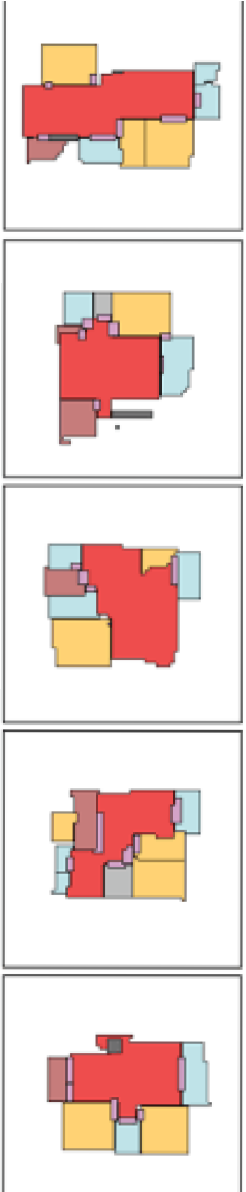
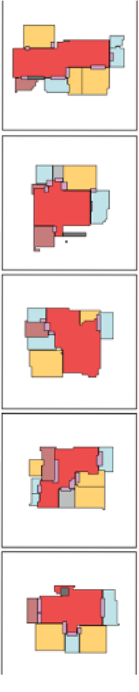

Capstone Phase B House-GAN++ B-23-06-R-14
Prof. Volkovich Zeev Dr. Avros Renata
Dorin Beery Mosa Hadish

Slide 2
Problem Overview
Generating floor plan with AI model

Slide 3
Experimental Phase
Experiment the model weaknesses
Inner rooms
Post training
Notes:
Present the experimental phase problem
Ellaborate on the connection between boxes edges and edrm
Solution: GUI utility to generate jsons, achieving dataset

Slide 4
Challenges and Solution
Post Training
Json Bugs
Demonstrate generation process with Google Collab
Migrating to Google Cloud

Slide 5
Challenges and Solution
Challenge: Post Training
Requires dataset of at least 1000 jsons.

Slide 6
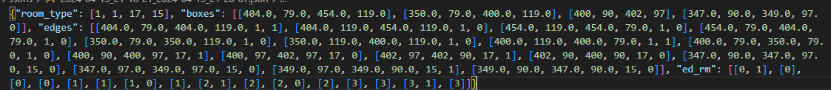
Challenges and Solution
Challenge: Post Training
Notes:
Explain about difficulties and unhuman structure

Slide 7
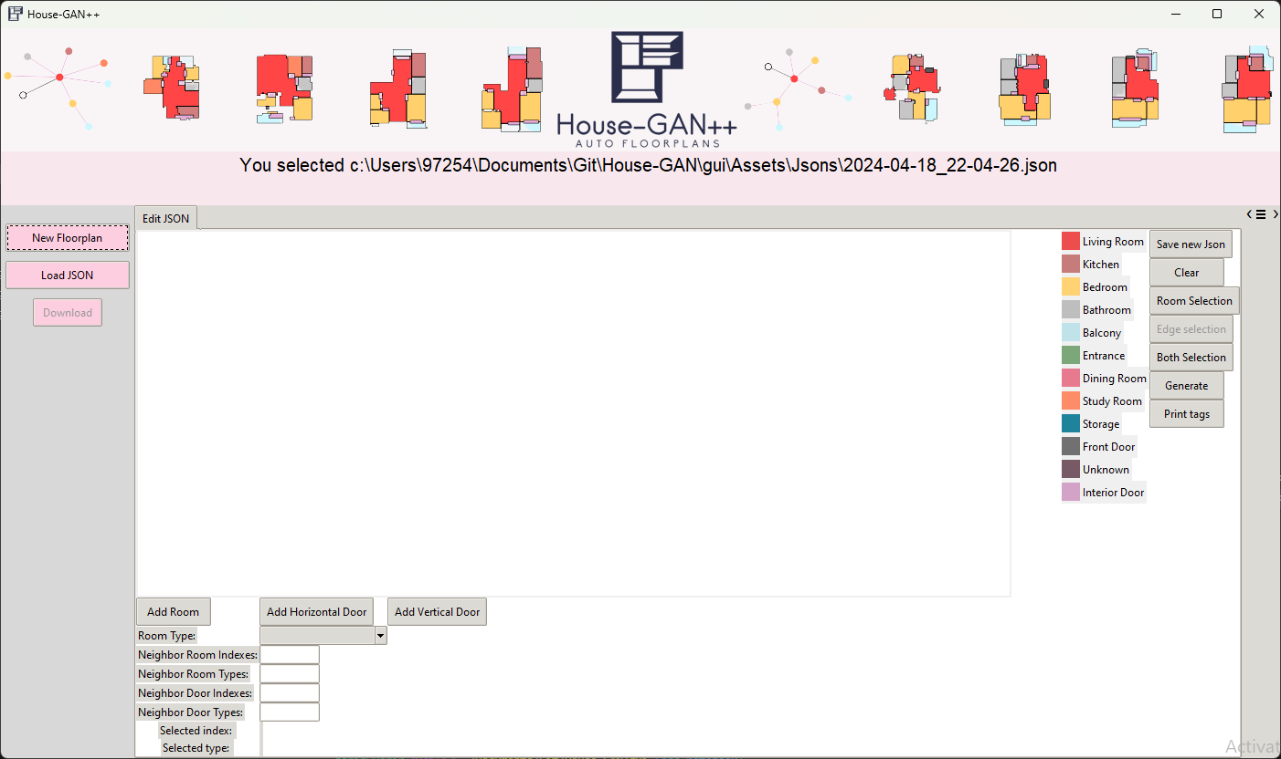
Challenges and Solution
Solution: Develop GUI Utility
Notes:
Handles all the problematic connections between edrm edges and boxes

Slide 8
Challenges and Solution
Challenge: Json Bugs
Json bugs floated till the very end of the development process due to inadequate comprehension of Json
Notes:
Emphesizes the problem of creating a dataset for post training

Slide 9
Challenges and Solution
Solution: Architecture
Our Architecture is composed of agile development and separation between GUI development and Json analysis

Slide 10
Challenges and Solution
Challenge: Google Collab
Loading Google Drive into Collab
Drive should contain the model
Every time there is a need to test the model – change the name of the Json contained in .txt file and drag the Json into the google drive folder.

Slide 11
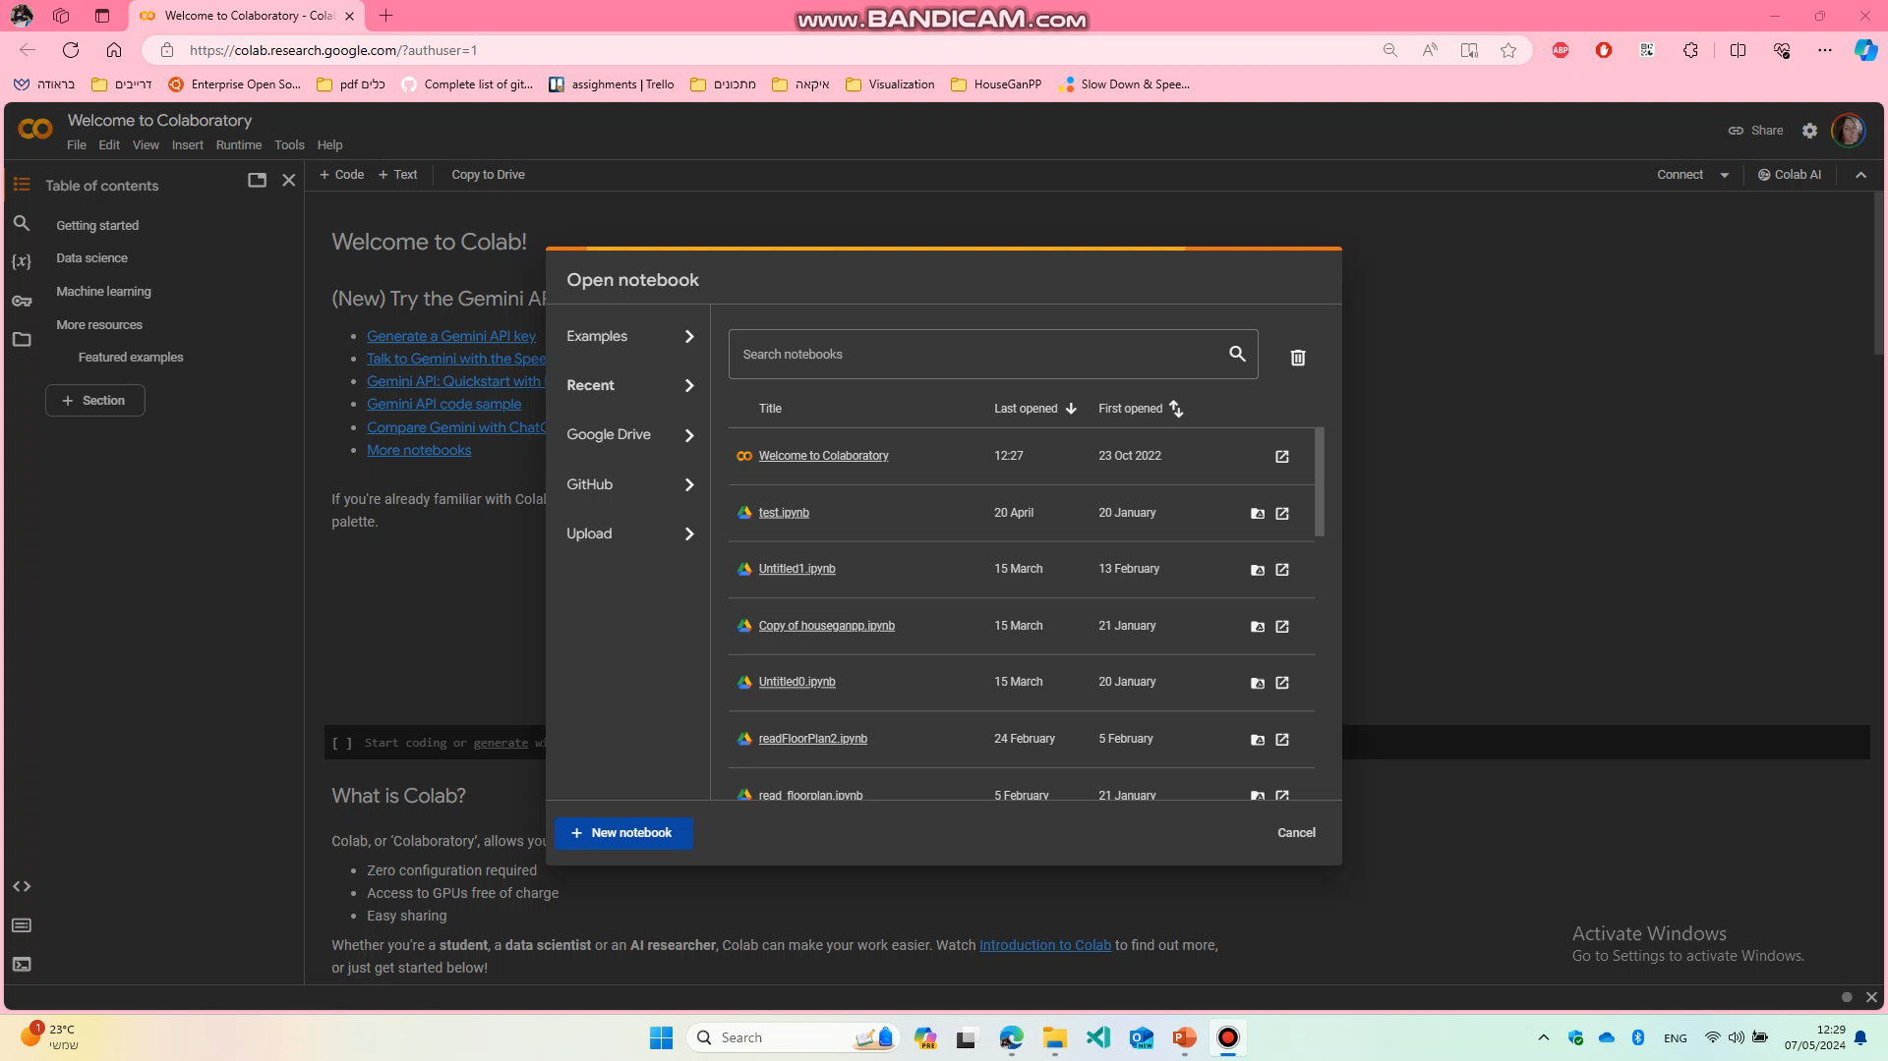

Slide 12
Challenges and Solution
Solution: Migrating to Google Cloud
Receive output from the model with a click of a button
Easier to compare between desired output and generated output
Bonus: House graph is also presented.

Slide 13
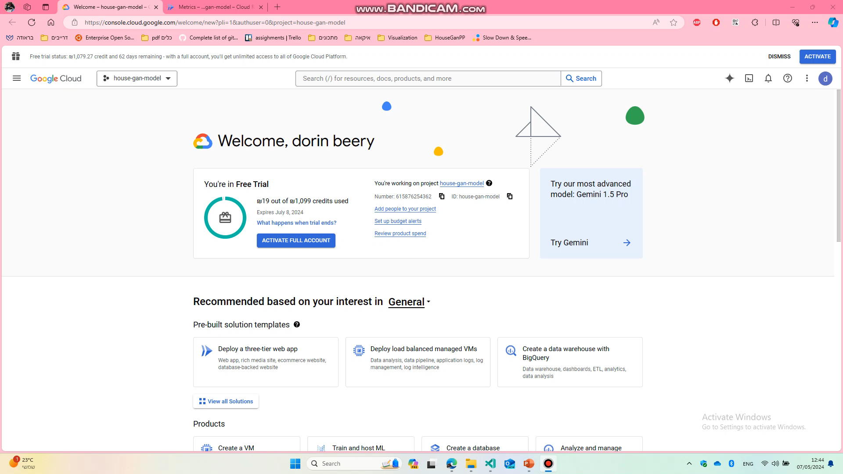

Slide 14
Challenges and Solution
Challenge: CUDA
Locally worked with CUDA
Then upgraded to Google Collab GPU
Then migrating to Google Cloud
Trying different services of Google Cloud:
Cloud Function
Cloud Run
Google VM
Kubernetes

Slide 15
Challenges and Solution
Solution: CPU
Change the code to work on CPU only.

Slide 16
Architecture
CI/CD
Git
Google Cloud Build
Google Artifact Register
2. Google Cloud Storage
3. Google Cloud Run
4. Agile Development
5. Separation Between Login(Json analysis) and GUI development.
Notes:
בעל פה

Slide 17
Testing Process
Model Testing
Test how the model handles different incomplete JSONs
2. GUI Testing
Test the validity of the generated json files and basic buttons of the GUI.
Notes:
בעל פה

Slide 18
Testing Process
Model Testing
The purpose of this section is to test how the model handles different incomplete JSONs.
For this section, we’ll be looking at and modifying an example that contains 6 rooms
Notes:
בעל פה

Slide 19
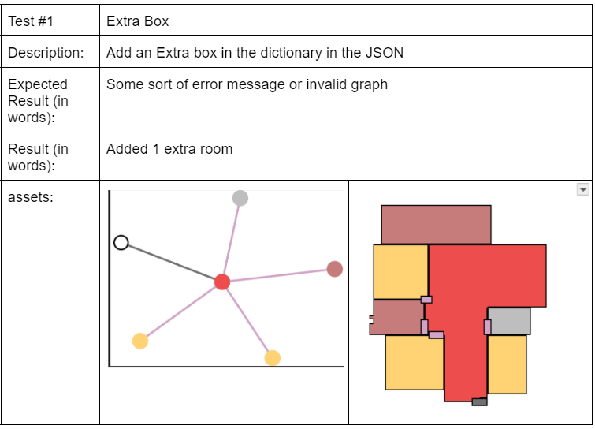
Testing Process
Model Testing #1: Extra Box
Notes:
בעל פה

Slide 20
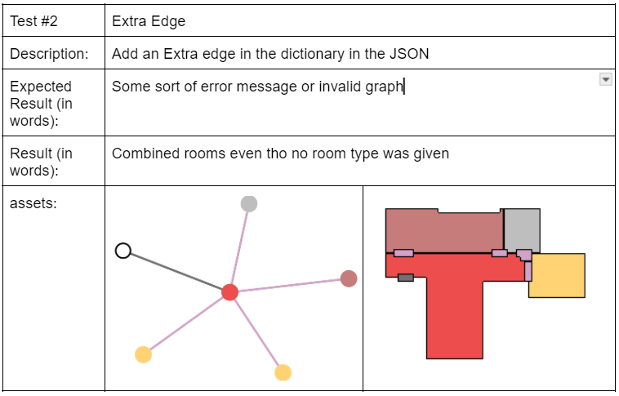
Testing Process
Model Testing #2: Extra Edge
Notes:
בעל פה

Slide 21
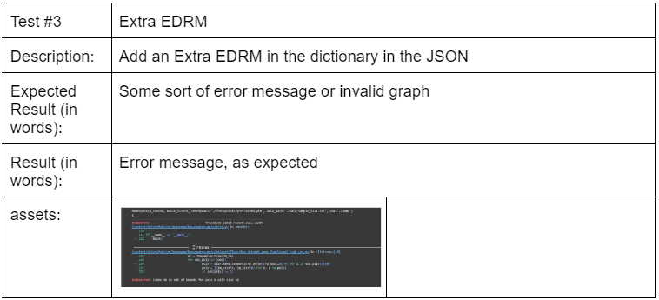
Testing Process
Model Testing #3: Extra EDRM
Notes:
בעל פה

Slide 22
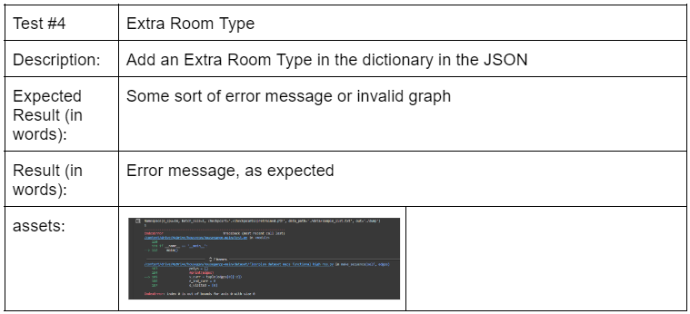
Testing Process
Model Testing #4: Extra Room Type
Notes:
בעל פה

Slide 23
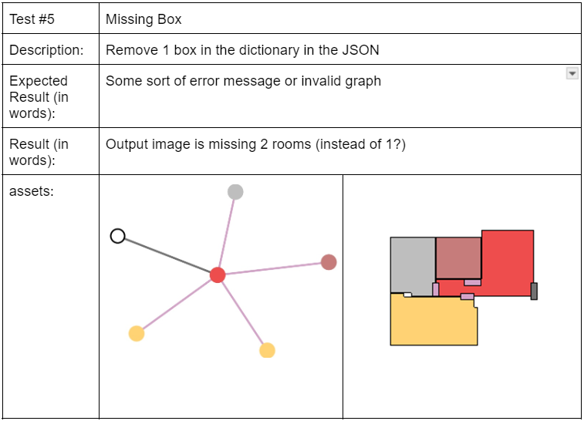
Testing Process
Model Testing #5: Missing Box
Notes:
בעל פה

Slide 24
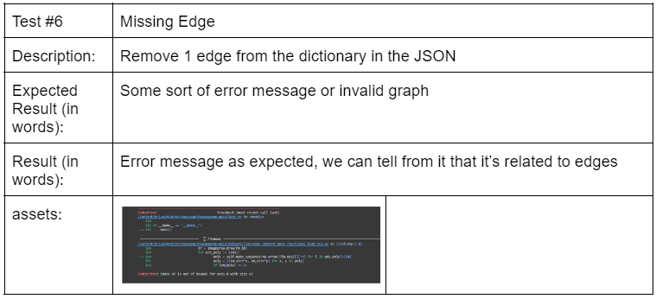
Testing Process
Model Testing #6: Missing Edge
Notes:
בעל פה

Slide 25
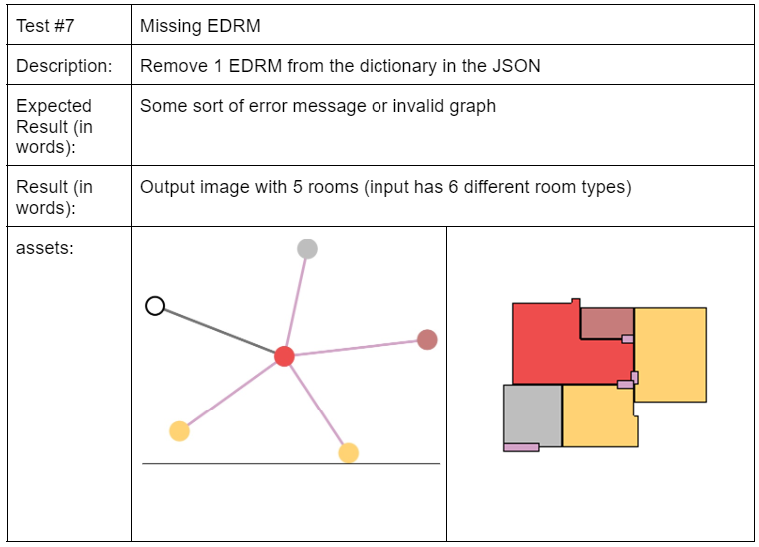
Testing Process
Model Testing #7: Missing EDRM
Notes:
בעל פה

Slide 26
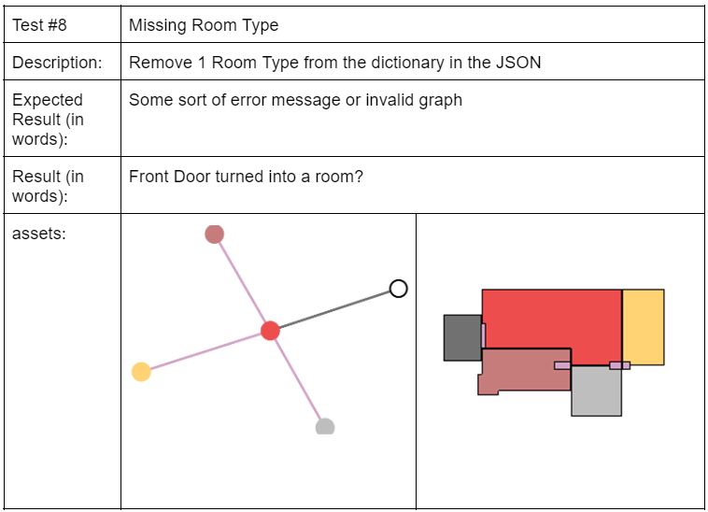
Testing Process
Model Testing #8: Missing RoomType
Notes:
בעל פה

Slide 27
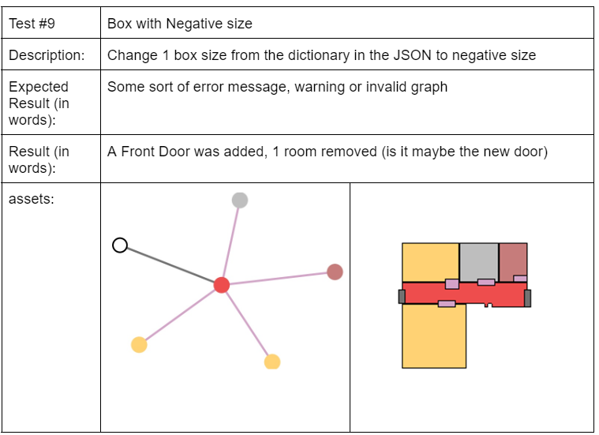
Testing Process
Model Testing #9: Negative Size Box
Notes:
בעל פה

Slide 28
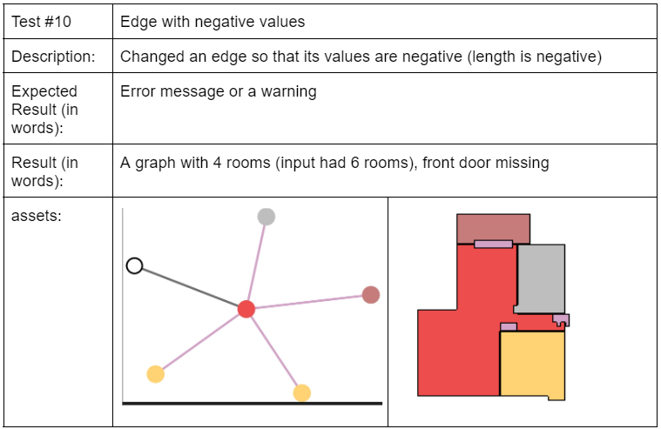
Testing Process
Model Testing #10: Negative Edge
Notes:
בעל פה

Slide 29
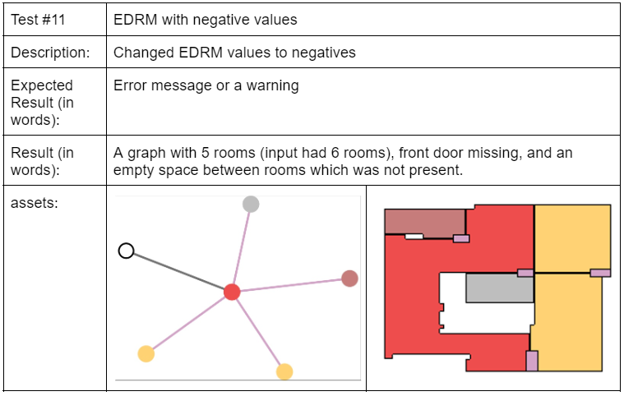
Testing Process
Model Testing #11: Negative EDRM
Notes:
בעל פה

Slide 30
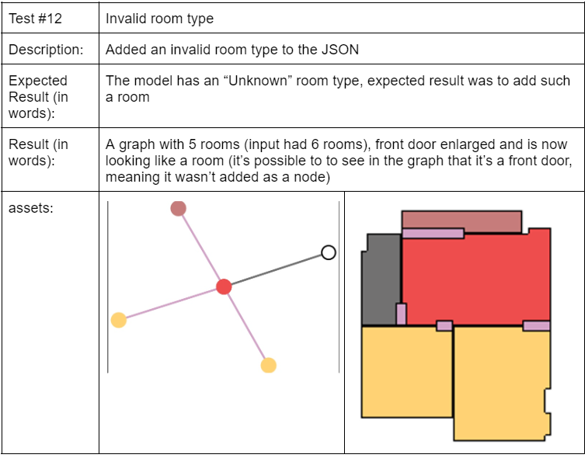
Testing Process
Model Testing #12: Invalid RoomType
Notes:
בעל פה

Slide 31
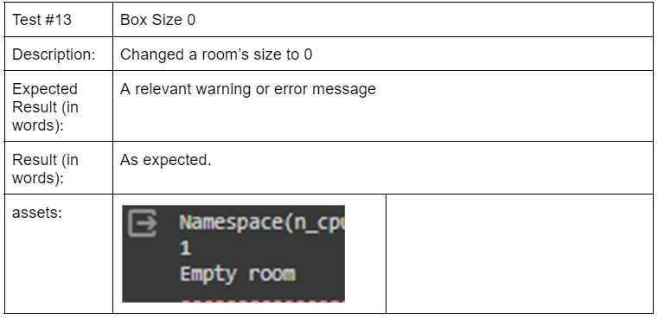
Testing Process
Model Testing #13: Box Size 0
Notes:
בעל פה

Slide 32
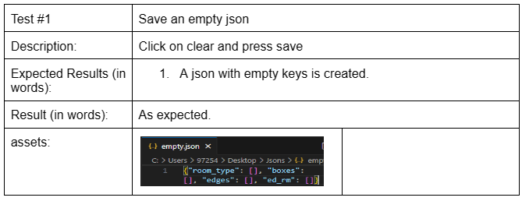
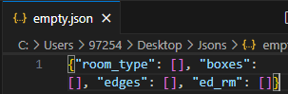
Testing Process
GUI Testing 1#
Notes:
בעל פה

Slide 33
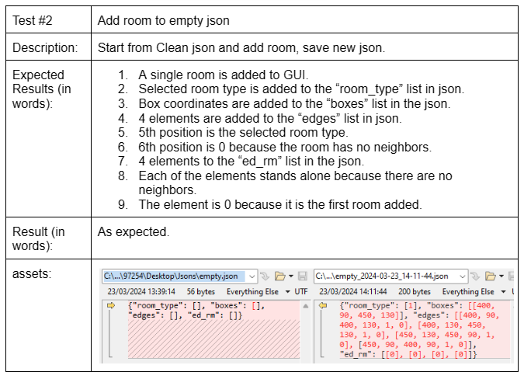
Testing Process
GUI Testing 2#
Notes:
בעל פה

Slide 34
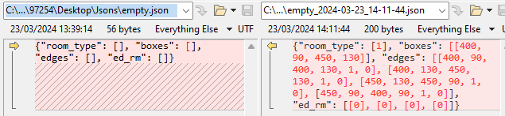
Testing Process
GUI Testing 2#
Notes:
בעל פה

Slide 35
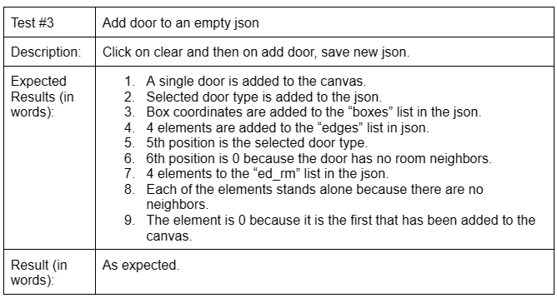
Testing Process
GUI Testing 3#
Notes:
בעל פה

Slide 36
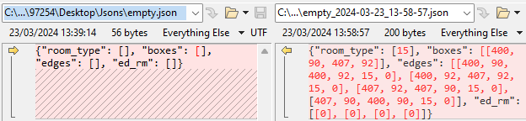
Testing Process
GUI Testing 3#
Notes:
בעל פה

Slide 37
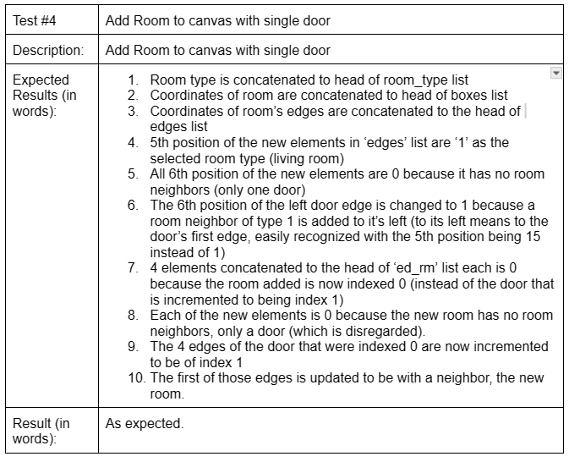
Testing Process
GUI Testing 4#
Notes:
בעל פה

Slide 38
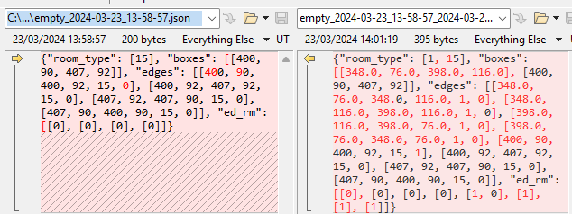
Testing Process
GUI Testing 4#
Notes:
בעל פה

Slide 39
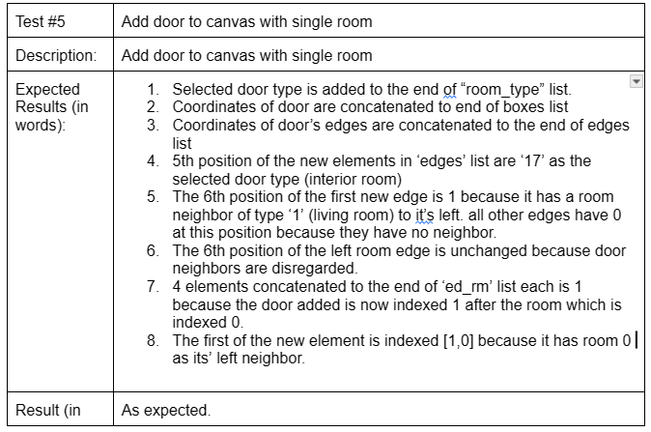
Testing Process
GUI Testing 5#
Notes:
בעל פה

Slide 40
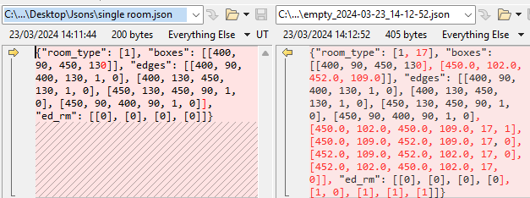
Testing Process
GUI Testing 5#
Notes:
בעל פה

Slide 41
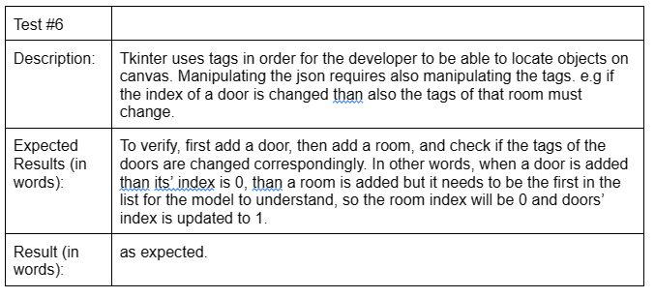
Testing Process
GUI Testing 6#
Notes:
בעל פה

Slide 42
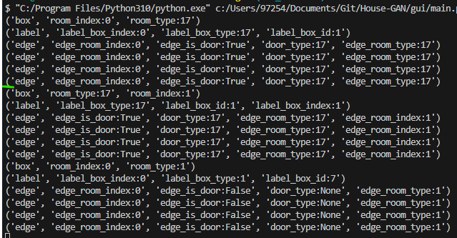
Testing Process
GUI Testing 6#
Notes:
בעל פה

Slide 43
Completion
To summarize we have achieved a GUI utility providing with capability to create floorplan datasets in order to post train the state-of-the-art HouseGan++ Model.
It Allows to add rooms and doors onto a canvas, fill in their neighbors, send a request to GCP and receive response. The response allows to analyze with ease the generated output, the desired output and the house graph in one window – in contrast to google collab or local generation.
The code is written in friendly manner with comments and separation between Gui logic, Json logic, and UI itself allowing for further implementation and collaboration in the journey for achieving a better model.
Notes:
בעל פה

Slide 44
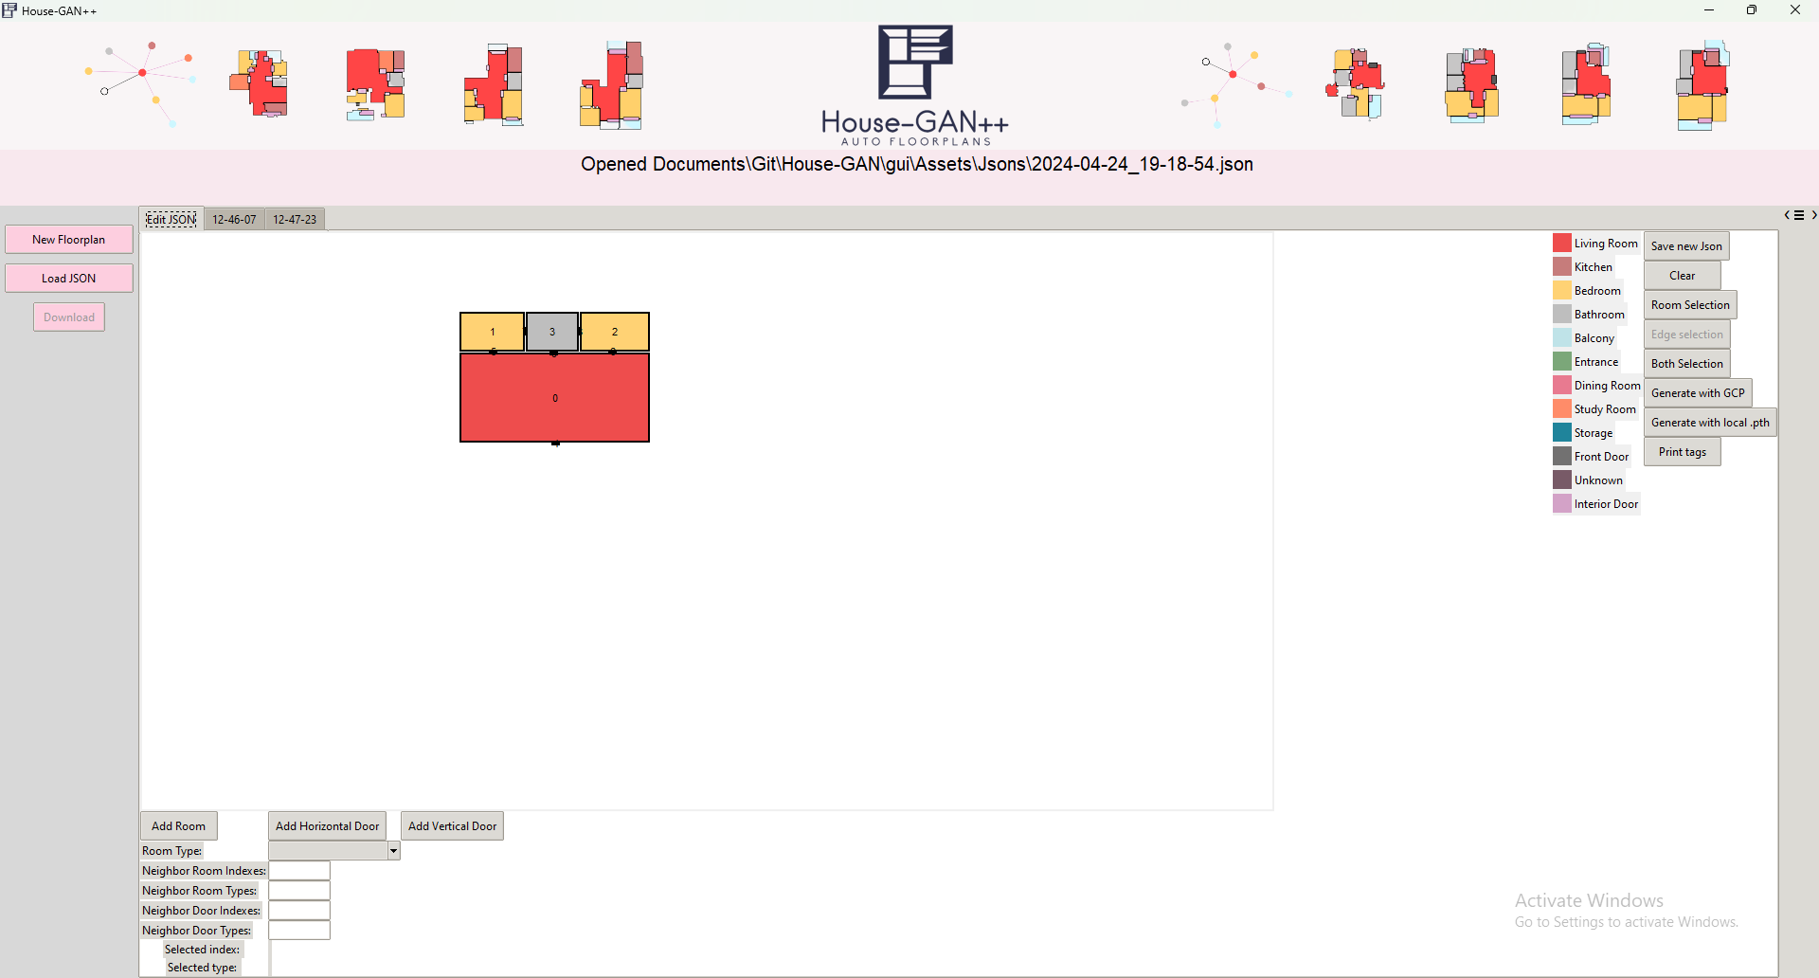
Completion
Notes:
בעל פה

Slide 45
Thank You

